Slide 1
Dog CPR and First Aid
Presented by
The Winnegamie Dog Club

Slide 2
Dog CPR and First Aid Seminar
Your dog is a family member, right?
You would do anything to save the life of a family member, right?
Learn what to do to keep your dog alive until you can get to your veterinarian with this comprehensive course.

Slide 3
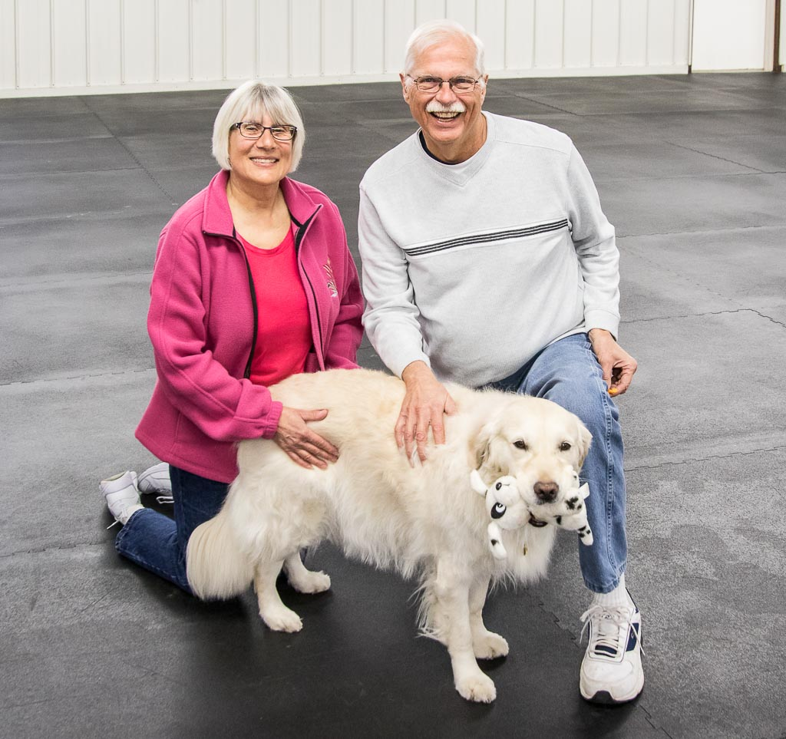
The instructors: Patty and Len Hoehne with Vivian
Patty has been training dogs for over 30 years and won numerous trophies. She has held many elected positions at the Winnegamie Dog Club. Len has been a trainer in law enforcement, real estate, human CPR and first aid. He is a past president and Board Member of the WDC. The two of them have been teaching Dog CPR and First Aid for over 10 years. They bring to the seminar an awesome amount of dog knowledge and training experience. They have a wonderful sense of humor to make the seminar fun and interesting. Vivian steals the show with her antics and looks. She has been helping with the class for 4 years.

Slide 4
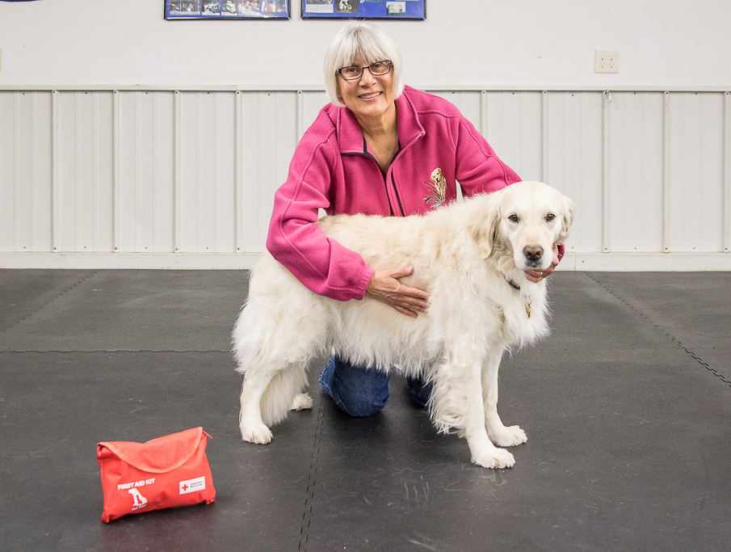
Interactive class
Vivian will let you locate her pulse so you can find it easier on your dog.
You are encouraged to practice finding the pulse, checking capillary refill, checking breathing, etc. on your dog.
Dog CPR manikins are provided so you can practice the skills of effective dog CPR and rescue breathing, Others are used to demonstrate controlling bleeding and splinting.
There is additional time available after class if you would like more practice.
Lots of take home information along with a 114 page Red Cross Dog First Aid book.

Slide 5
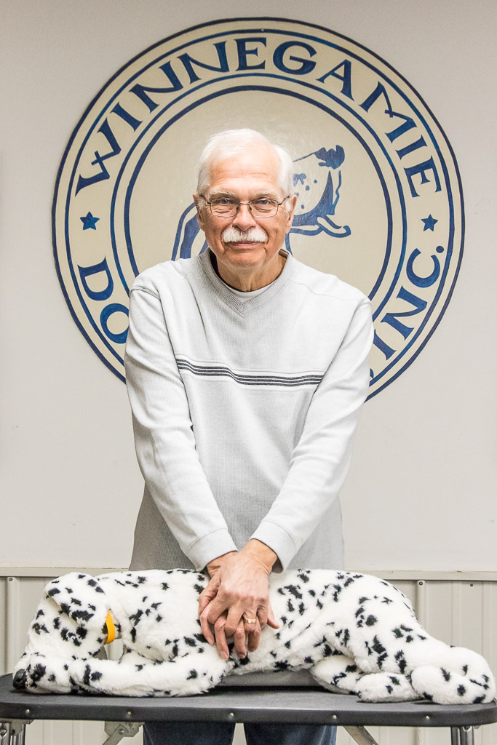
Yes, you can do CPR for your dog
Len demonstrates correct hand position for chest compressions.
The latest standard is 30 compressions and 2 breathes.
Proper hand placement and depth of compressions is essential in performing CPR.

Slide 6
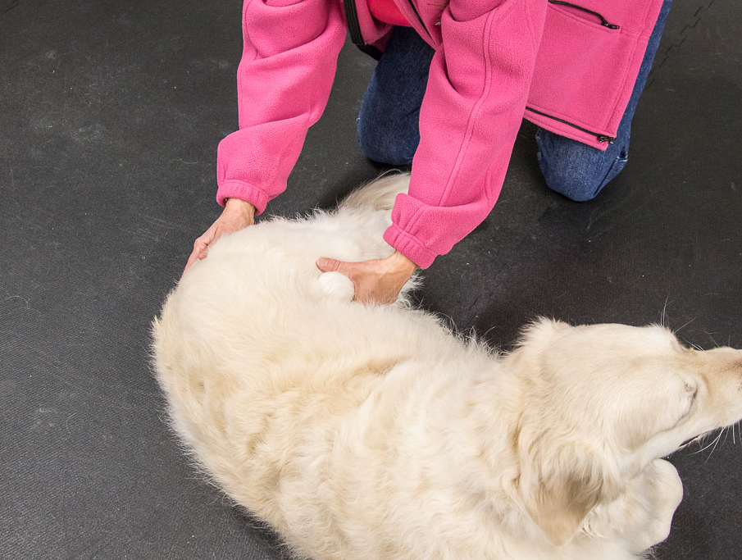
Finding your dog’s pulse
You must know how and where to find your dog’s pulse so you can determine what is “Normal” for him/her. Patty and Vivian are showing how to find her pulse on the femoral artery.
There are several other places to find the dog’s pulse.
The size of the dog determines what a “Normal” pulse rate should be.

Slide 7
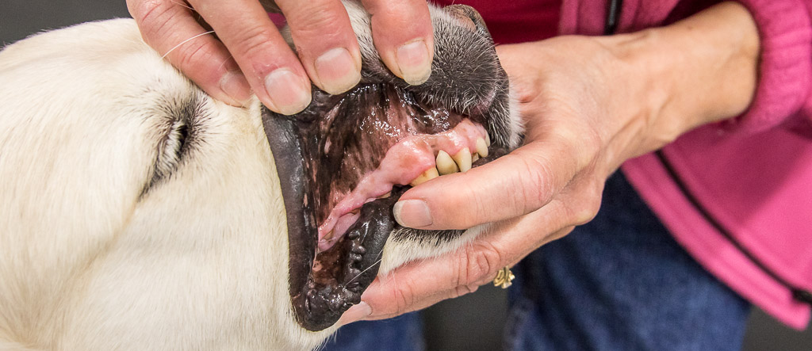
Vivian and Patty demonstrate how to check capillary refill as part of what is “normal” for my dog.

Slide 8
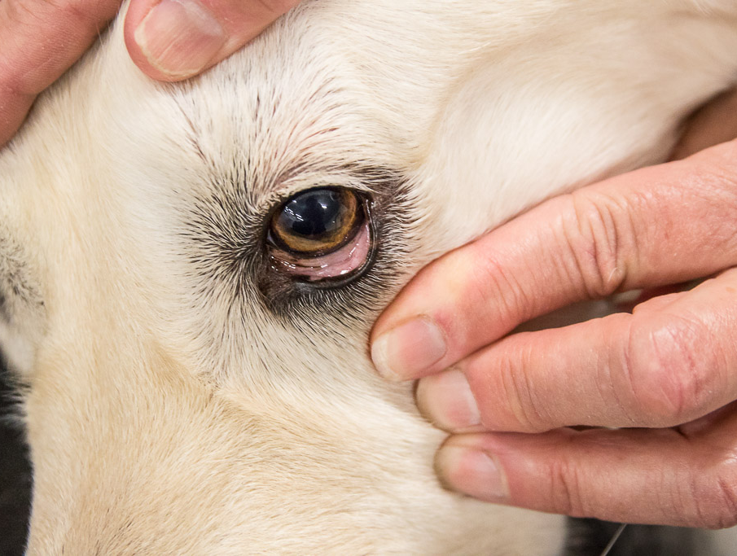
The eyes are another check of what’s “normal”

Slide 9
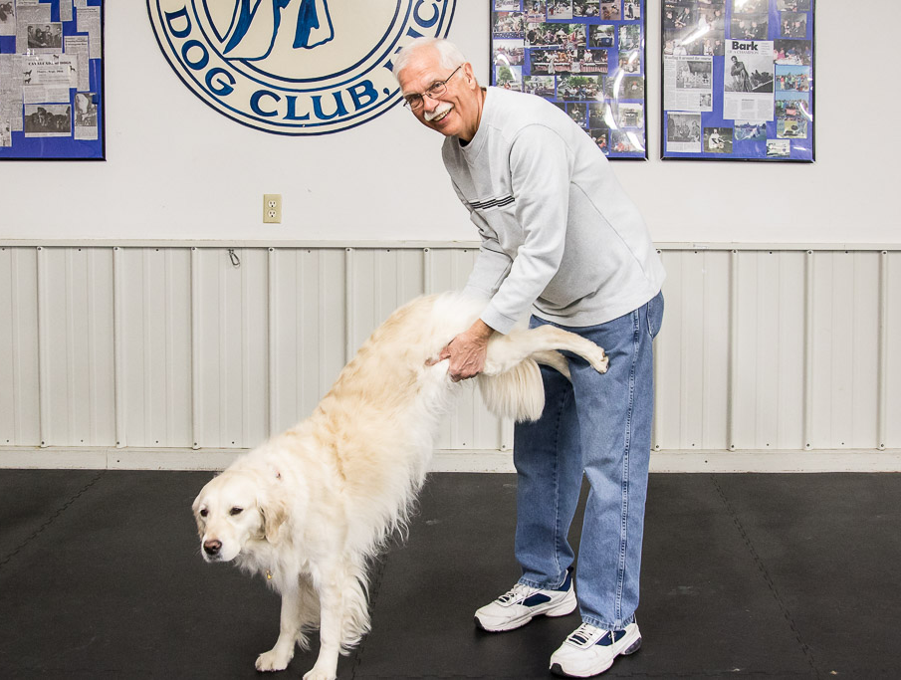
Dogs can choke on many things
Knowing how to dislodge an object a dog is choking on is essential!
Vivian is showing the “wheelbarrow” position used to dislodge an object blocking her airway.
There’s nothing funny about a choking dog but Vivian’s look was too funny for Len. He had to smile.

Slide 10
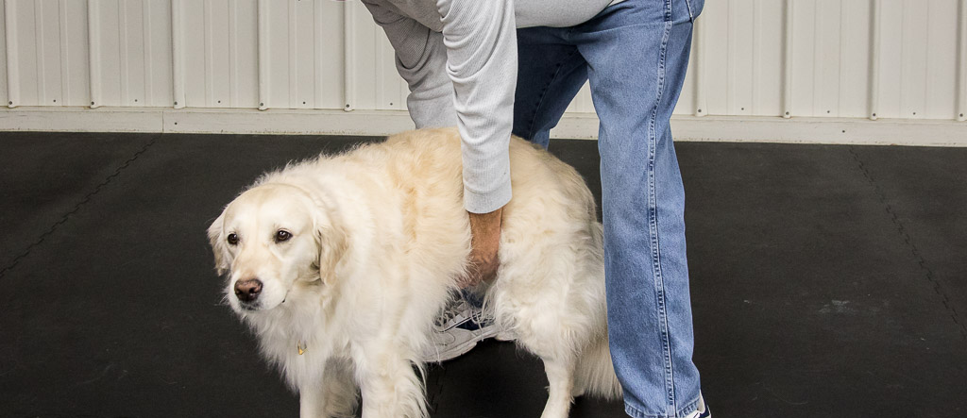
Abdominal thrusts to dislodge an object works on dogs.
Miss “V” says “You owe me 3 treats for this abuse Bucko!!”.

Slide 11
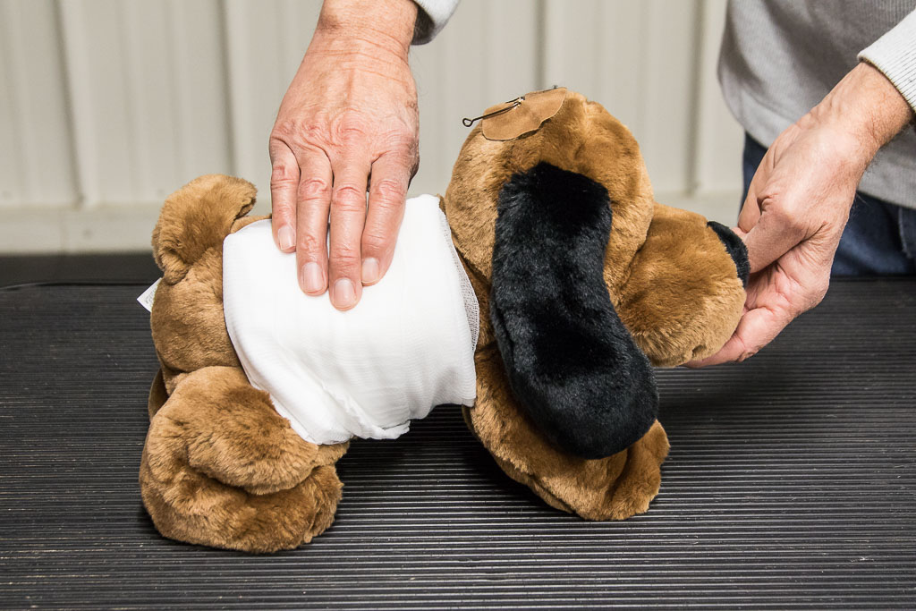
Control severe bleeding by applying direct pressure.
No tourniquets here!
Direct pressure will control nearly all bleeding emergencies.
If its “squirtin’ squeeze it”.

Slide 12
Controlling bleeding can save your dog’s life
Several techniques are demonstrated to control severe bleeding.
Yes, that’s a fish hook on the “dogikin’s” head. Hook removal is explained in class.

Slide 13
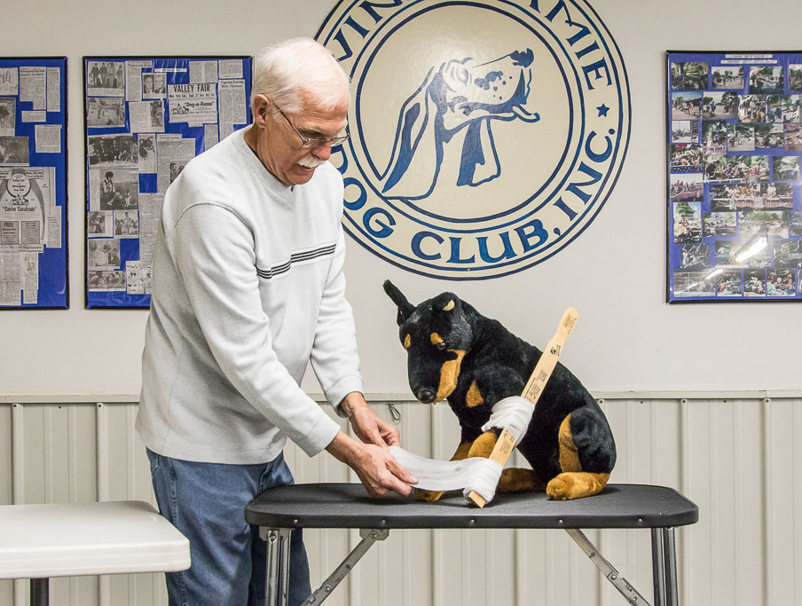
Splinting a leg
It may become necessary to splint a dog’s leg that is injured.
Only under limited circumstances.
Do no further harm.
Bandage above and below the injured part.
That’s one sad “Dobie”.

Slide 14
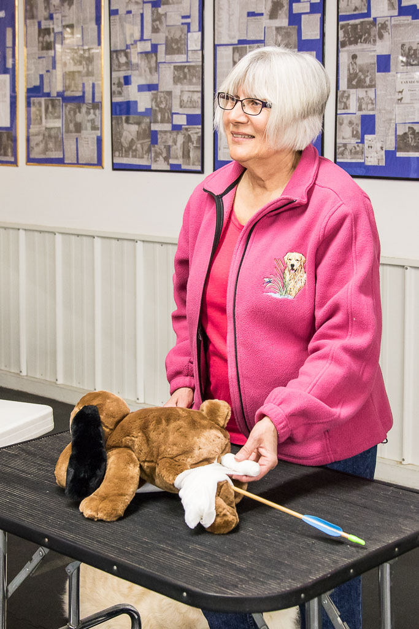
Horrible accidents occur in a dog’s life!
An embedded object, in this photo an arrow, requires special handling.
Do NOT remove the object!
Bulk dressings are applied to stabilize the object.
Extreme care is needed so there is no further damage to internal organs.

Slide 15
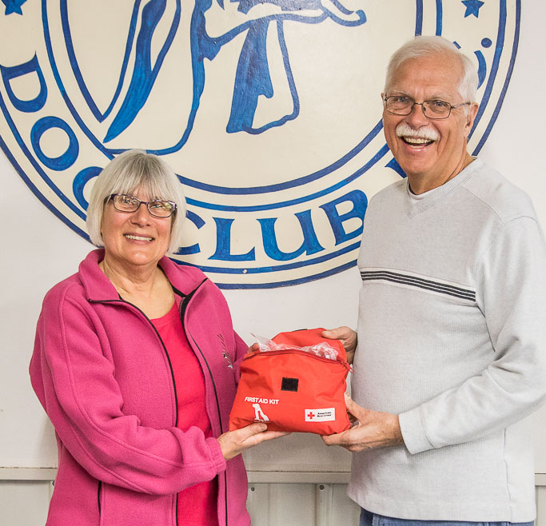
A first aid kit is always a necessity.
The instructors show a dog first aid kit available through the American Red Cross.
The seminar describes what is needed in a home first aid kit for you and your pets.
Build your own kit with the list of items shown in class.
A Disaster Kit is another piece of “being prepared”.

Slide 16
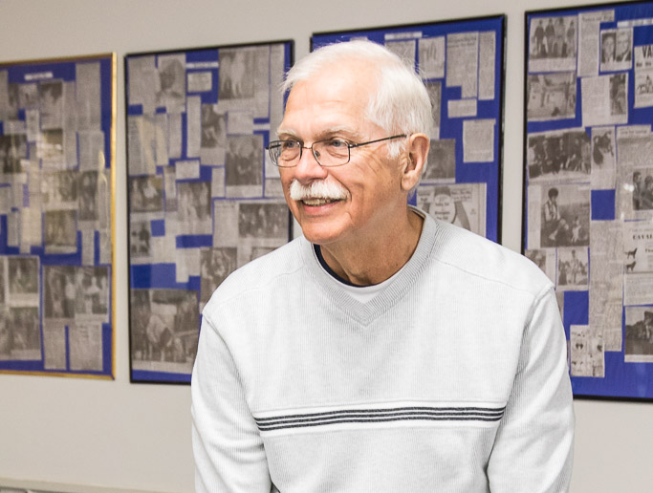
Questions from class members are always welcome
Len listens carefully to a question. The instructors have a lot of experience and knowledge to draw from so they can answer nearly all questions.
If the instructors don’t have an answer, someone else in class may have. We learn a lot from each class.

Slide 17
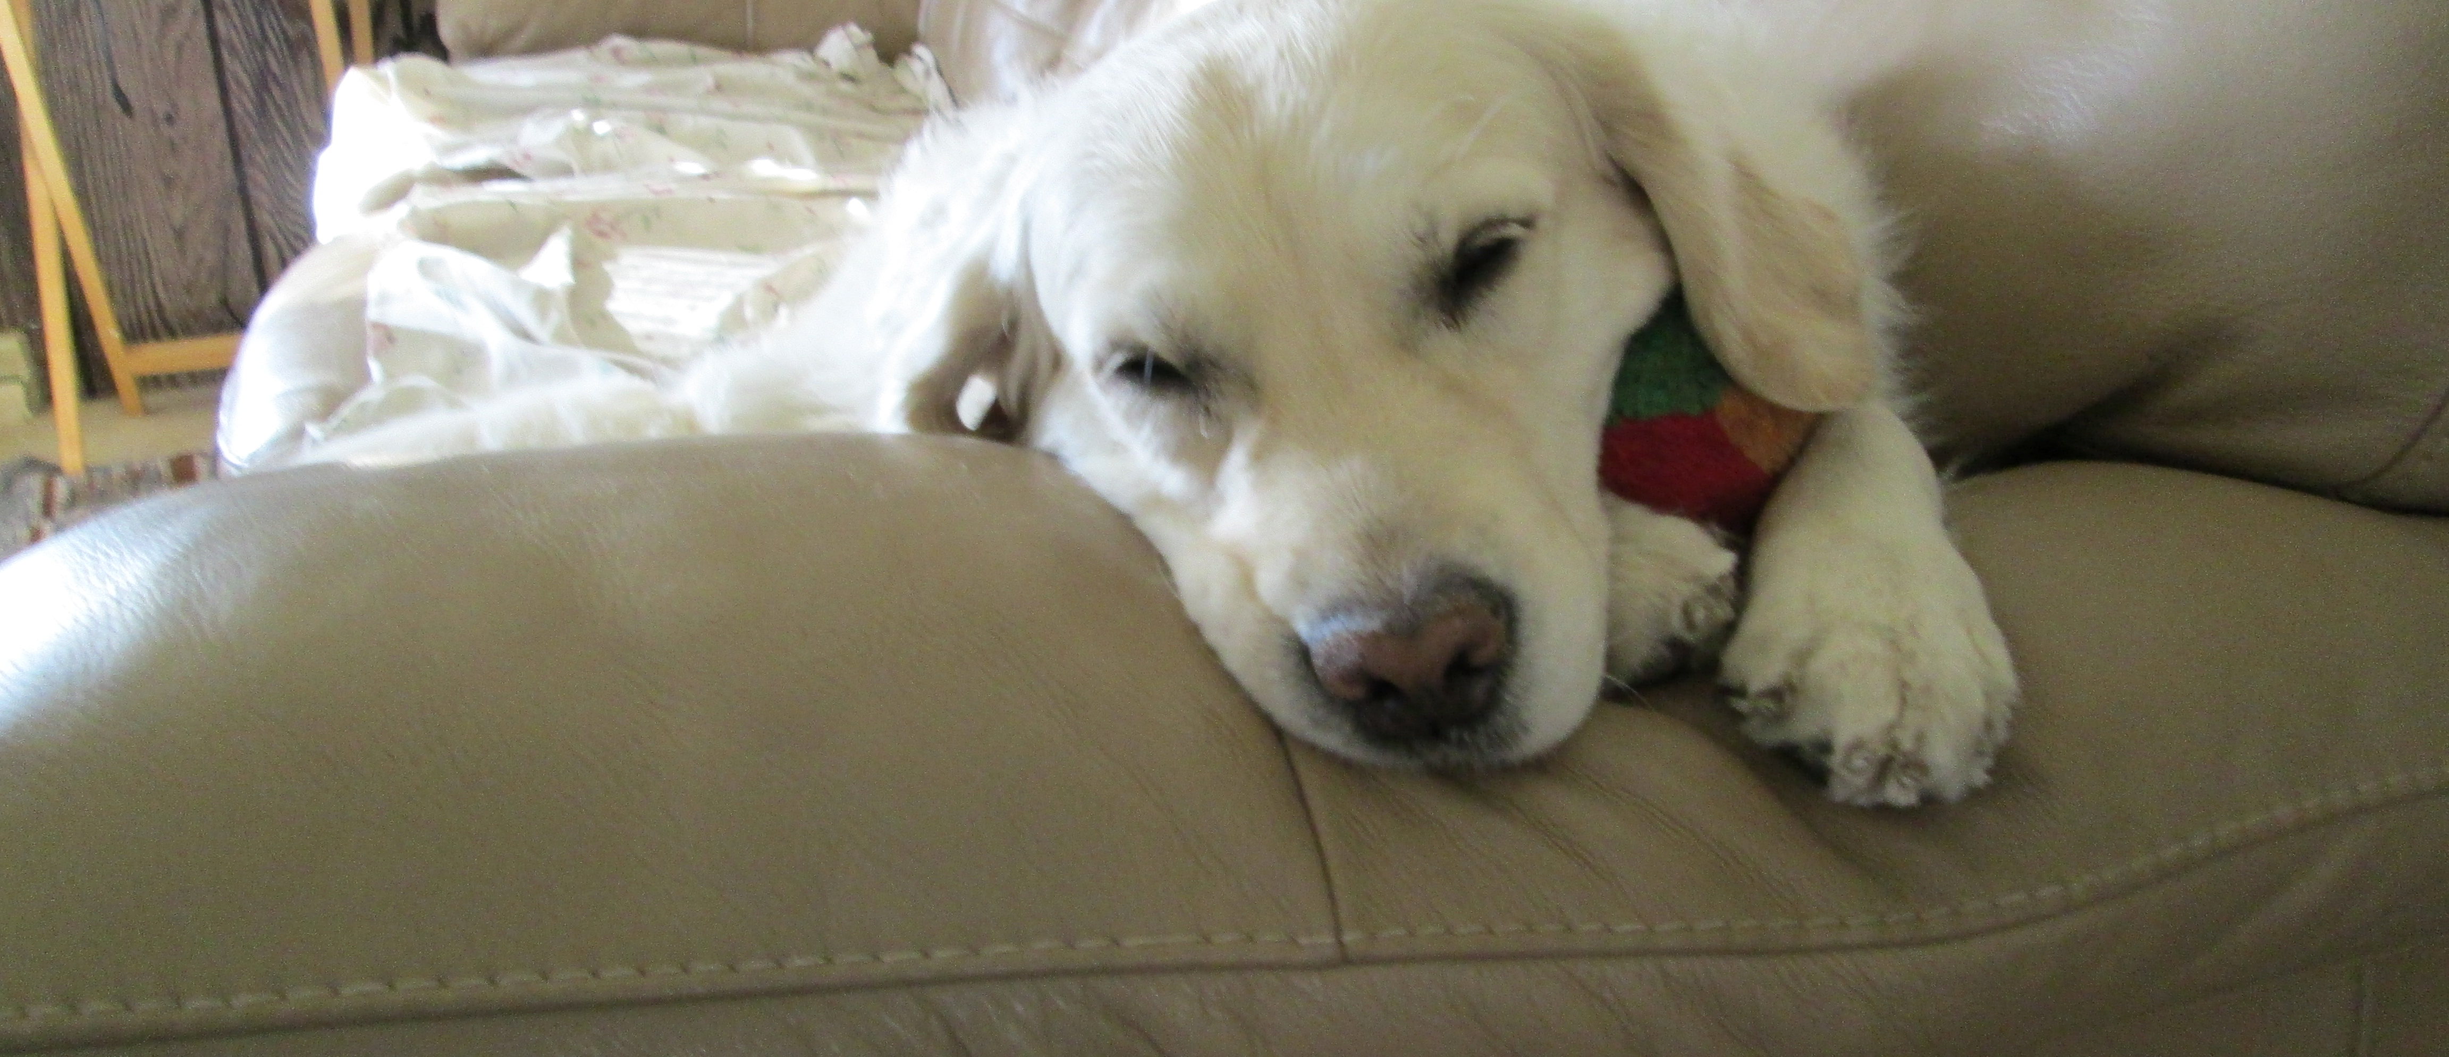
Vivian says, “Registration in advance is required”
Registration form is available at winnegamiedogclub.com. Class size is limited so register now.

